Slide 1

MCA Major Project End Term Evaluation
Analytical Research for Product Growth & Management
Under the guidance of
Dr. Amritpal Kaur
Department of Computer Applications
Faculty of Science, Technology and Architecture
Manipal University Jaipur
By
Jatin Israni
23FS20MCA00081
2023-25

Slide 2
Outline
Introduction
Motivation
Process Model
Scope of the Project
Methodology & Planning
Tools & Technologies Used
Power BI Report & Dashboard
Conclusion

Slide 3
Introduction
About the Company – Glokal Technologies & Allure Cosmetics
Glokal Technologies is a digital-first company focused on delivering tech-enabled solutions across various sectors. One of its key brands, Allure Cosmetics, is a premium online beauty platform launched in 2018. Allure Cosmetics offers a wide range of authentic skincare, makeup, haircare, and personal care products from top national and international brands. With a strong presence on platforms like Nykaa, Amazon, Flipkart, and Myntra, Allure aims to provide a high-quality, customer-centric shopping experience for beauty enthusiasts across India.

Slide 4
About the Project:-
This project was completed during my internship at Glokal Technologies, focusing on their beauty brand Allure Cosmetics. The aim was to help the company grow by using data to understand customer needs, improve products, and stay ahead of competitors.
I used tools like Power BI, and Excel to study sales data, customer behavior, and market trends. I also looked at what competitors are offering and how customers are responding.
The project helped identify which products are doing well, which ones need improvement, and how we can make better decisions based on real data. The final goal was to give practical suggestions that can increase customer satisfaction, boost sales, and support long-term growth.

Slide 5
Motivation
In the beauty industry, customer choices change very fast.
Many companies have data but don’t use it fully to improve their products.
Allure Cosmetics wanted to better understand its customers and grow its brand.
The project was done to:
Use data to make smarter decisions
Find what customers like or don’t like
Improve product performance
Help the company stay ahead of the competition

Slide 6
Process Model
Steps Followed in This Project:
Research & Collection – Gathered market trends, customer feedback, and competitor data via analytics and surveys.
2. Data Analysis – Studied product sales, profit, and user behavior using KPIs like DAU, MAU, churn, and conversions.
3. Insights – Identified customer needs, issues, and Allure's standing against competitors.
4. Strategy – Proposed product enhancements and marketing/growth plans.
5. Dashboards – Created Power BI dashboards for visual reporting.
6. Recommendations – Offered clear, actionable suggestions and a growth roadmap.

Slide 7
Scope of the Project
This project aims to drive data-informed decision-making for product growth and management at Allure Cosmetics, focusing on improving customer satisfaction and market performance. The scope includes:
Market Research :- Analyzing demographics, customer preferences, and industry trends to identify target segments and growth opportunities.
Competitor Benchmarking :- Comparing Allure's offerings with competitors in terms of pricing, features, and customer value to uncover differentiation strategies.
Performance Metrics Analysis :- Evaluating user engagement, retention, and KPIs like DAU, MAU, churn rate, and conversion rate to assess product health and usage patterns.
Growth Strategy Development :- Designing market penetration strategies and scaling plans based on research insights and business objectives.

Slide 8
5. Product Optimization :- Using MoSCoW prioritization to enhance features and address customer pain points for improved user experience and ROI.
6. Data Visualization & Reporting :- Creating interactive Power BI dashboards and visual reports to support strategic planning and stakeholder communication.
7. Recommendations & Roadmap :- Delivering actionable insights and a future roadmap to boost product performance and support sustainable growth.
04
8

Slide 9
Methodology & Planning
Research Design: Mixed methods using surveys, analytics, and market data
Data Collection: From customer feedback, Google Analytics, competitor reports
Data Analysis: Evaluated KPIs – DAU, MAU, churn, conversion, sales, and profit
Insights: Identified user needs, pain points, and market opportunities
Strategy: Planned product improvements and growth strategies
Visualization: Built Power BI dashboards for interactive reporting
Recommendations: Provided actionable insights and a future roadmap

Slide 10
Tools & Technologies Used
Data Analytics
Google Analytics for tracking user behavior and traffic
Power BI for building interactive dashboards
Microsoft Excel for data cleaning and analysis
Market Research
Industry reports to study market trends
Surveys to gather customer feedback
Competitor analysis to benchmark features and pricing
Visualization & Reporting
PowerPoint for presenting findings
Google Sheets for collaborative data sharing
Hardware Requirements
Minimum 10 GB free hard disk space for smooth operation

Slide 11
Power BI Report & Dashboard
In this project, we have used the following data fields:
Order ID
Amount
Profit
Quantity
Order Date
Ship Date
Ship Mode
Product ID
Category
Sub-Category
Payment Mode

Slide 12
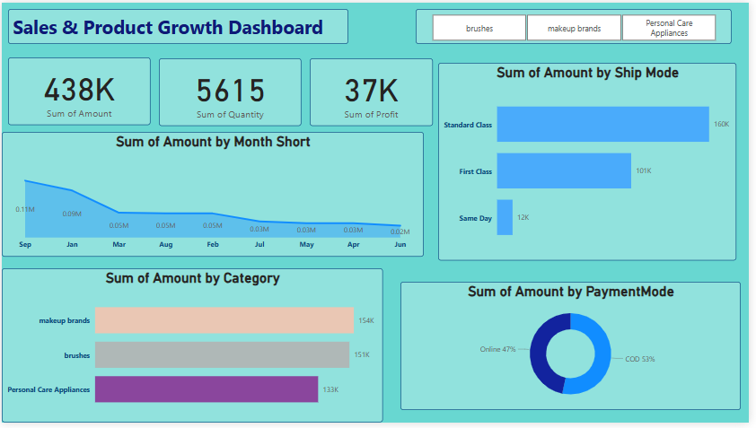
Dashboard Overview
The Power BI dashboard titled “Sales & Product Growth Dashboard” provides a comprehensive visual summary of the company’s sales, profit, product categories, shipping methods, payment modes, and monthly trends. Below is a snapshot of the complete dashboard:

Slide 13
Conclusion
This Sales & Product Growth Dashboard provides a clear and structured way to understand business performance using Power BI.
It helps track key numbers like sales, profit, and product performance.
We can see trends over time, like monthly sales changes and shipping timelines.
It shows customer preferences, including how they pay and which shipping methods they choose.
By analyzing this data, we can spot what’s working and find areas to improve.
Power BI helps turn raw data into easy visuals, making it simple to make smarter, faster decisions.
This project also supports product growth by using real data to guide strategy. With continuous research and a data-driven approach, businesses can adapt quickly, stay competitive, and grow stronger in a changing market.

Slide 14
Thank you!

